Slide 1

Visualization and Analysis of Clickstream Data
Guide:
D.HARITHA
Team members: M.Samyuktha
2451-12-733-047

Slide 2

ABSTRACT
Click stream data is an information trail a user leaves behind while visiting a website. It is typically captured in semi-structured website log files. Hadoop makes it easier to analyze, visualize and ultimately change how visitors behave on the website. We can answer business questions such as:
What is the most efficient path for a site visitor to research a product, and then buy it?
What products do visitors tend to buy together, and what are they most likely to buy in the future?
Where should I spend resources on fixing or enhancing the user experience on my website?
We focus on the “path optimization” use case. Specifically: how can we improve our website to reduce bounce rates and improve conversion.

Slide 3


To VISUALIZE WEB SITE Click Stream DATA using Hadoop.
Problem Statement
Notes:
Notes: Every ecommerce business needs to track and analyse clickstream data to grow their business. Many analytics programs, including Google Analytics, come with basic clickstream analysis functionality. In Google it’s called as “site overlay”. There are so many solutions to deal with this issue. But by using traditional databases to load and process the clickstream data involves complexities while storing and streaming the customer’s information. And its take much processing time to analyse and visualize it. One way to solve this problem and improve performance is by using the structure of Hadoop which provides the large scale fast processing ecosystem environment. There are so many tools to provide this architecture in real time for enterprises. Here in this paper we use Hortonworks to load and process the sample clickstream data. And after analysing it, the data is visualized by power view tools to track the information.

Slide 4

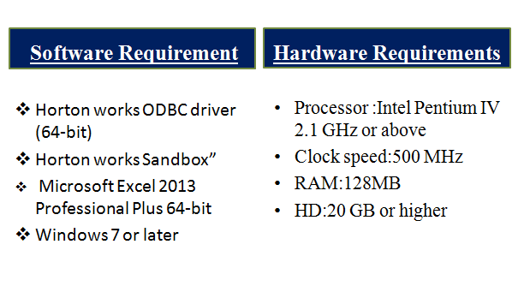


Slide 5
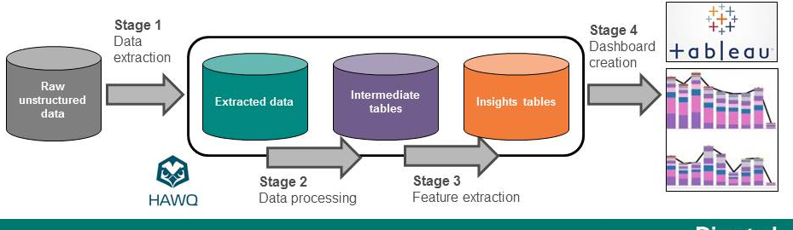

BASIC ARCHITECTURE

Slide 6

TooLLLSSS... && SoFtwaRe

Slide 7


Sand Box VM
A separate physical machine
Involves installing an OS
Runs a different operating system
Virtual machine and its host are effectively isolated

Slide 8

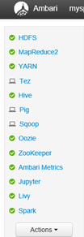

Smart Configuration
Data access engines
Customised UI
Scalable Storage
Hadoop Cluster
Security
Dash Boards
Metrics
Notes:
1.Can optimise manage jobs within storage processing managing tasks using hdfs(storage of diff types of data) , yarn(allows access to large clusters in a single ui) , pig( scripting ) , hive(query lang , huge jobs , fast tez engine with explain). 2. single node or repository accessing all jobs like streaming preprocessing data storage n visuali 3. dashboards 4.hdfs 5. sec admin cn capture audit info frm (say hdfs n blah) , encapsulate data , authenticate users passwords. 6. manage monitor provide cluster setup

Slide 9


Data gathering
Extraction of weblogs
Storing and structuring data
Pattern mining
Data analysis
Data visualization

Slide 10

Data Analysis & Visualization
It is a process of
inspecting
cleaning
transforming
modelling data
with the goal of :
discovering useful information
suggesting conclusions
supporting decision-making

Slide 11
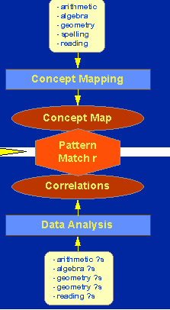

Pattern matching
Focuses on the recognition of patterns and regularities in data.
Pattern matching always involves an attempt to link two patterns where one is a theoretical pattern and the other is an observed or operational one.

Slide 12
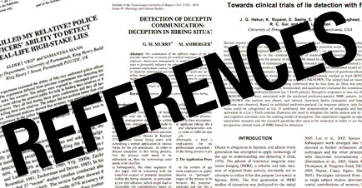
http://searchdatamanagement.techtarget.com/definition/Apache-Hive
http://www.webopedia.com/TERM/H/hive.html
http://conferences.oreilly.com/mysql2011/public/schedule/detail/16850
http://hortonworks.com/hdp/whats-new/
http://www.journals.elsevier.com/pattern-recognition/

